Slide 1
Final Project
By: Hussein El-Souri

Slide 2


Initial Ideas
Pointer Table
Informational GUI
Panic
Panic
Pimp My Ride???

Slide 3
Pimp my ride
Side view
Front View
Back View

Slide 4
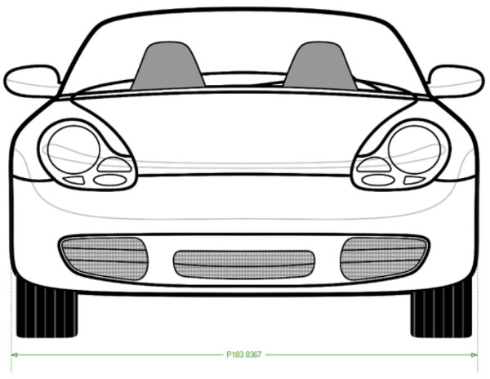
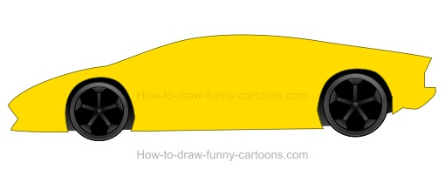
Design Schematics/Inspirations

Slide 5
Cons Vs Pros
Cons
Pros
Overly Simplistic
Seems easy but pathing and bindind shapes to pixels is difficult.
Simple
Fun
Eye Candy

Slide 6
Bugs and Possible Improvement
Bugs
Improvements
Side view limitations
Interior design
Flashing blinkers
Whippers
Door/hood/trunk open
Basically adding more Details

Slide 7
The End

